Slide 1
Online Claims Entry Adjustment, Void and Re-bill
Conduent
Government Healthcare Solutions

Slide 2
Resources
When online use: Ask Service Representative
HIPAA.Desk.NM@Conduent.com
NMProviderSupport@Conduent.com
Call Center 505-246-0710 or 800-299-7304
New Mexico Web Portal
Provider Information section
Links and FAQ section
Provider Login section

Slide 3
Important State Websites
STATE WEBSITE:
PROGRAM POLICY MANUAL
http://www.hsd.state.nm.us/mad/policymanual.html
BILLING INSTRUCTIONS
http://www.hsd.state.nm.us/mad/billinginstructions.html
REGISTERS AND SUPPLEMENTS:
http://www.hsd.state.nm.us/mad/registers/2012.html

Slide 4
Adjustments
A paid claim can be adjusted.
Providers CAN NOT adjust a denied claim.
ONLY Claims that have been processed through Online Claims Entry can be adjusted online. Claims processed through EDI or on paper CAN NOT be adjusted on the web portal.
Attach any new attachments pertinent to the adjustment.

Slide 5
Adjustments – Filing Limit
Adjustments must be submitted within 90 days from the date on the RA, for the paid claim.

Slide 6
Submitting an Adjustment
Conduent
Government Healthcare Solutions

Slide 7
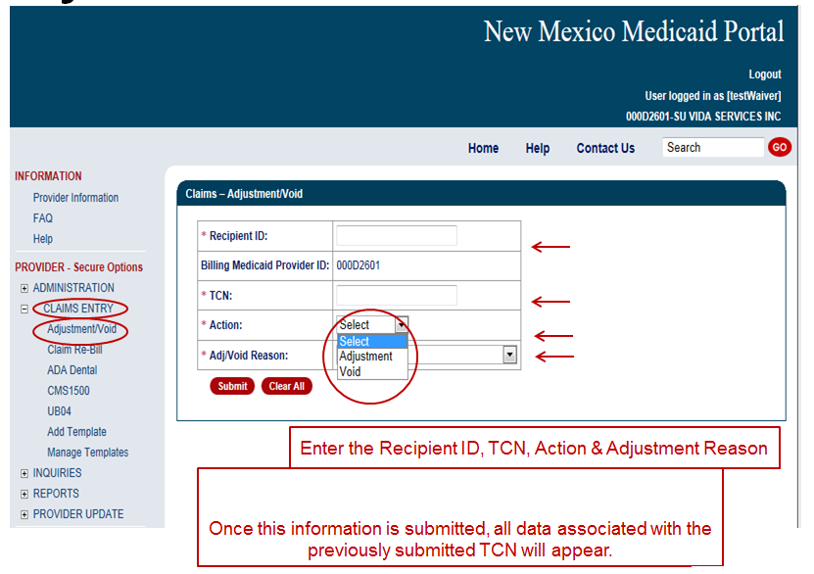
Adjustments

Slide 8
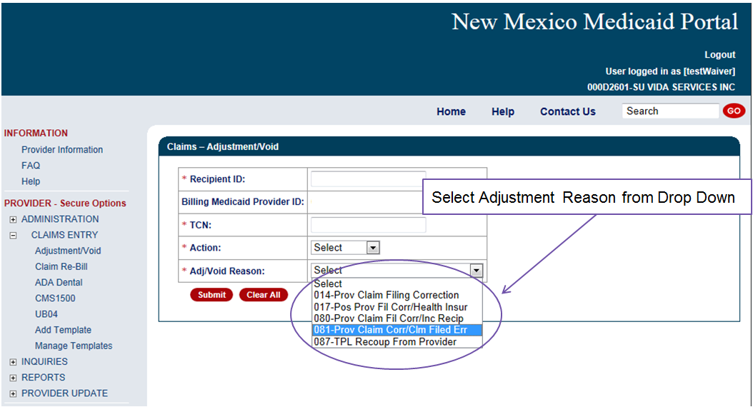
Adjustments

Slide 9
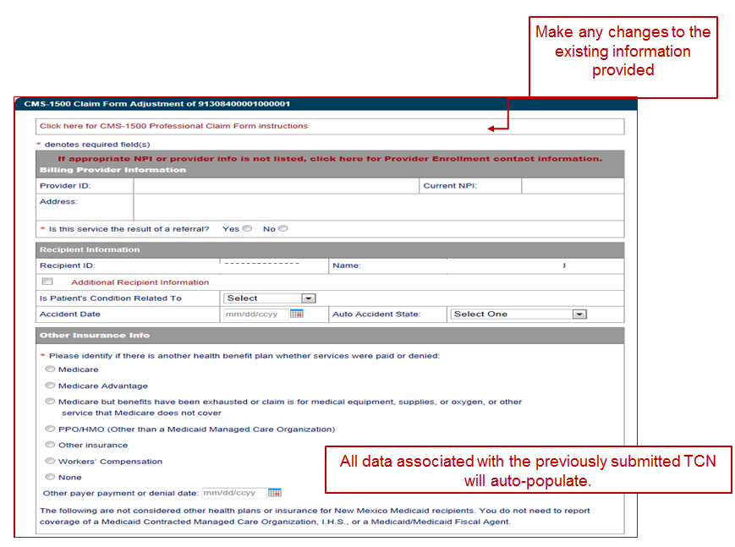
CMS- 1500 Adjustment Form

Slide 10
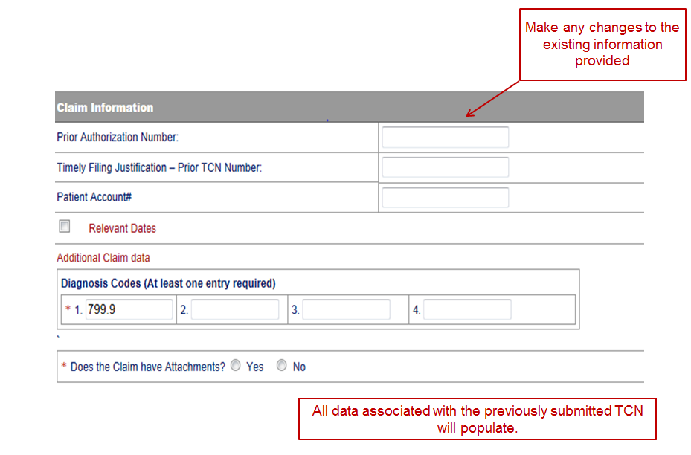
CMS- 1500 Adjustment Form

Slide 11
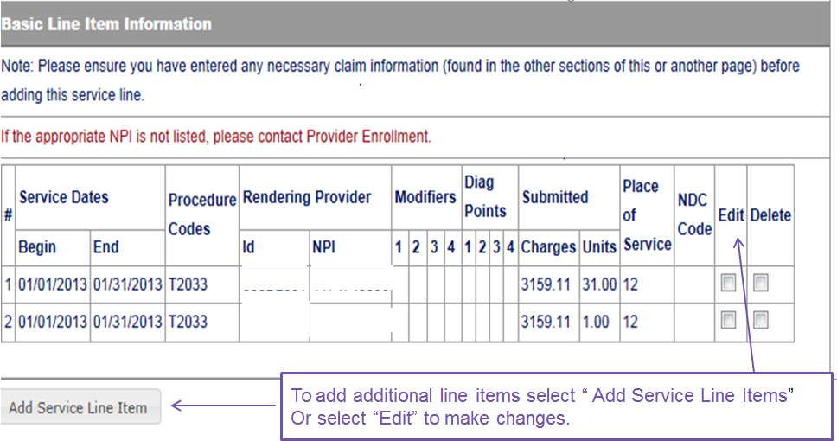
All data associated with the previously submitted TCN will auto-populate
Make any changes to the existing information provided
To add additional line items, select “Add Service Line Item” Select “Edit” to make changes to lines already populated.
Notes:
continued

Slide 12
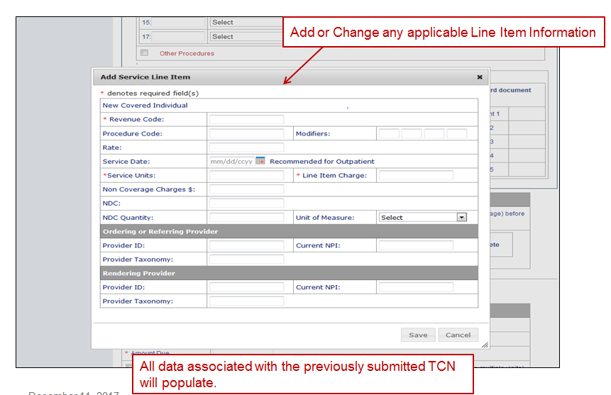
CMS- 1500 Adjustment Form

Slide 13
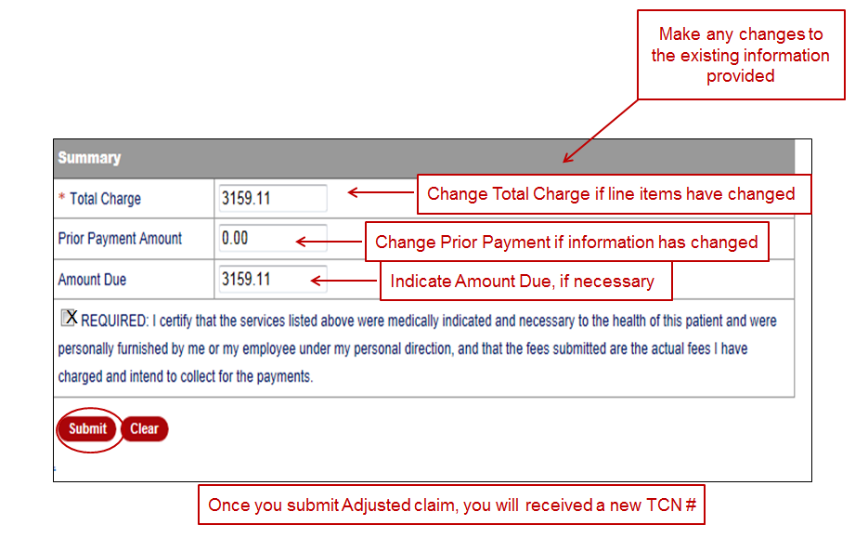
CMS- 1500 Adjustment Form

Slide 14
UB-04 Adjustments
Conduent
Government Healthcare Solutions

Slide 15
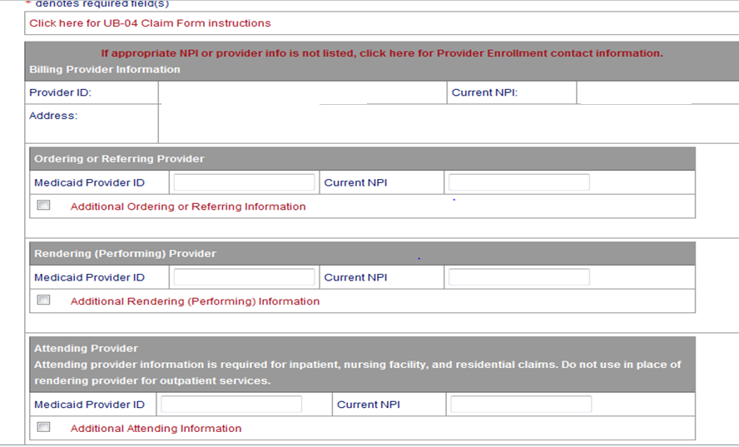
UB-04 Adjustments
Make any changes to the existing information provided
All data associated with the previously submitted TCN will auto-populate

Slide 16
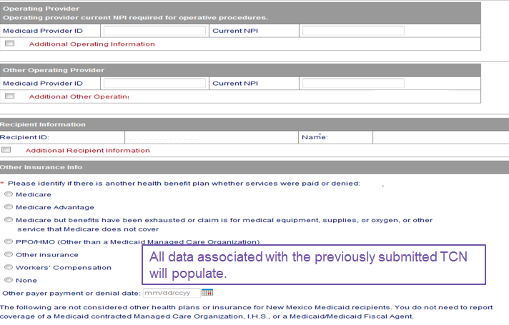
UB-04 Adjustments
Make any changes to the existing information provided
All data associated with the previously submitted TCN will auto-populate
Notes:
continued

Slide 17
UB-04 Adjustments
All data associated with the previously submitted TCN will auto-populate
Make any changes to the existing information provided
Notes:
continued

Slide 18
UB-04 Adjustments
All data associated with the previously submitted TCN will auto-populate
Make any changes to the existing information provided
Notes:
continued

Slide 19
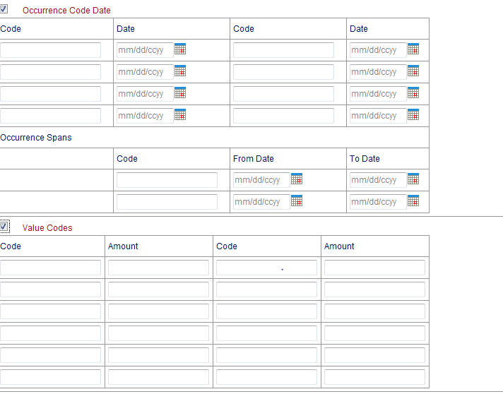
UB-04 Adjustments
All data associated with the previously submitted TCN will auto-populate
Make any changes to the existing information provided
Notes:
continued

Slide 20
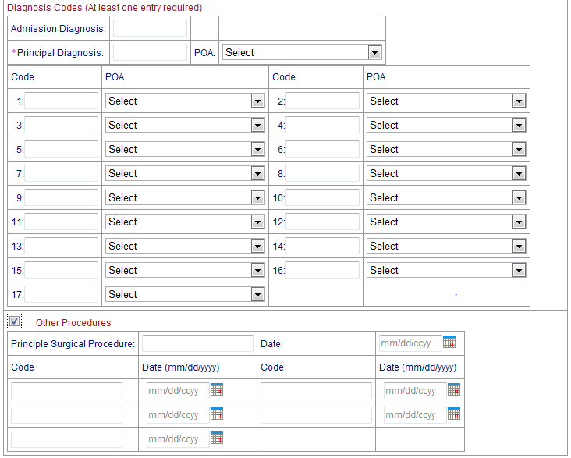
UB-04 Adjustments
All data associated with the previously submitted TCN will auto-populate
Make any changes to the existing information provided
Notes:
continued

Slide 21
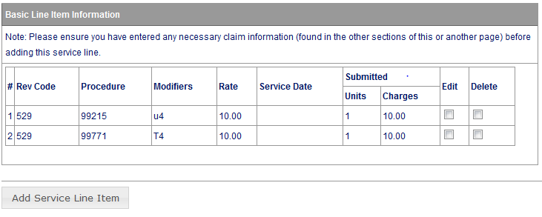
UB-04 Adjustments
All data associated with the previously submitted TCN will auto-populate
Make any changes to the existing information provided
To add additional line items, select “Add Service Line Items” Select “Edit” to make changes to lines already populated.
Notes:
continued

Slide 22
UB-04 Adjustments
All data associated with the previously submitted TCN will auto-populate
Make any changes to the existing information provided
Notes:
continued

Slide 23
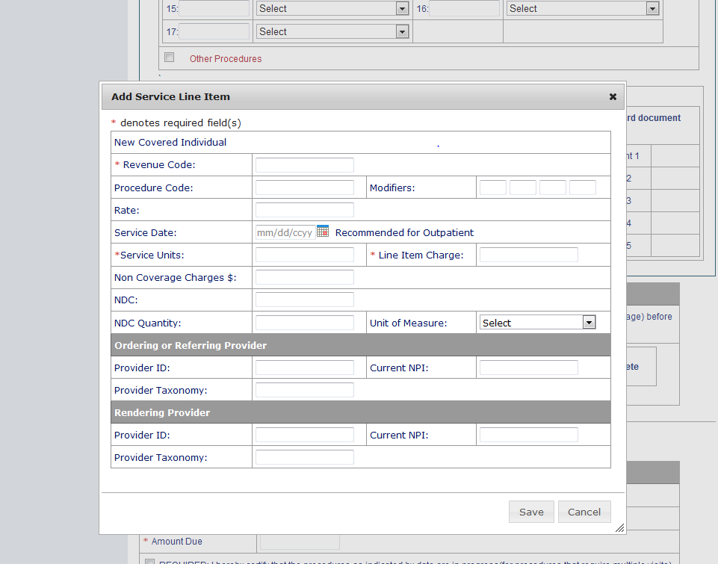
UB-04 Adjustments
All data associated with the previously submitted TCN will auto-populate
Make any changes to the existing information provided
Notes:
continued

Slide 24
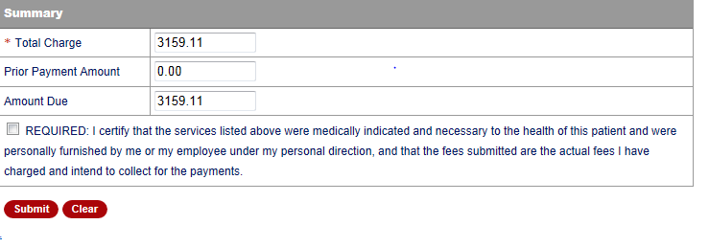
UB-04 Adjustments
All data associated with the previously submitted TCN will auto-populate
X
Make any changes to the existing information provided
Once adjusted claim is submitted, a new TCN will be generated.
Notes:
Ending step.

Slide 25
Adjustments – Filing Guidelines Recap
Make any changes to the existing information provided on the previously submitted TCN. Only make changes to data that will impact the adjustment.
Indicate Timely Filing Justification TCN number provided in the claim information section.

Slide 26
Submitting a Void
Conduent
Government Healthcare Solutions

Slide 27
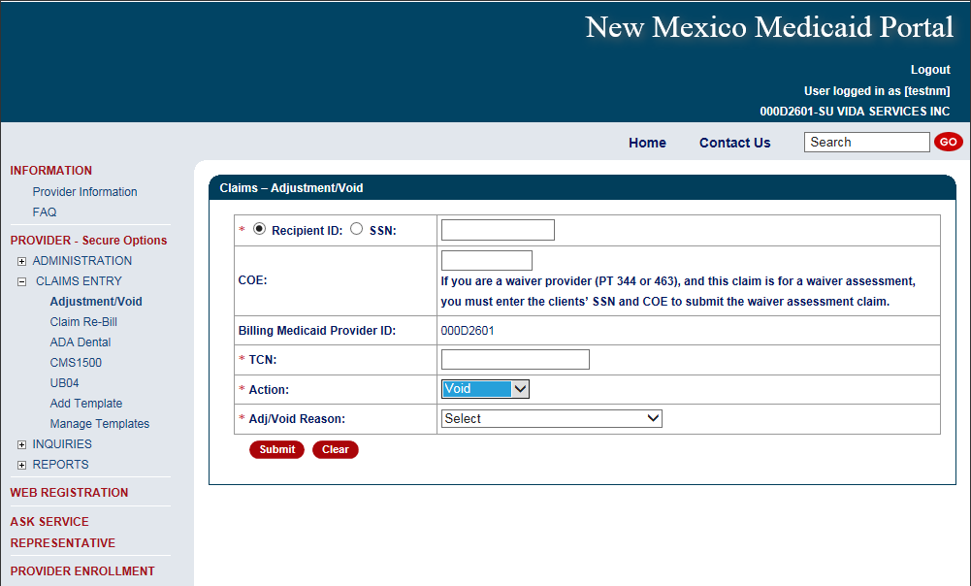
Void Request
Enter The Recipient ID, TCN, Action, & Void Reason

Slide 28
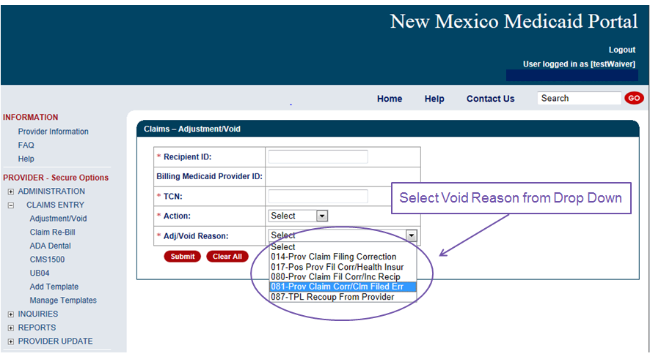
Void Request

Slide 29
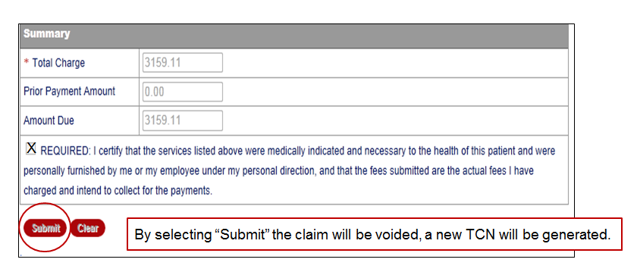
Void Request

Slide 30
Claims Re-bill
Conduent
Government Healthcare Solutions

Slide 31
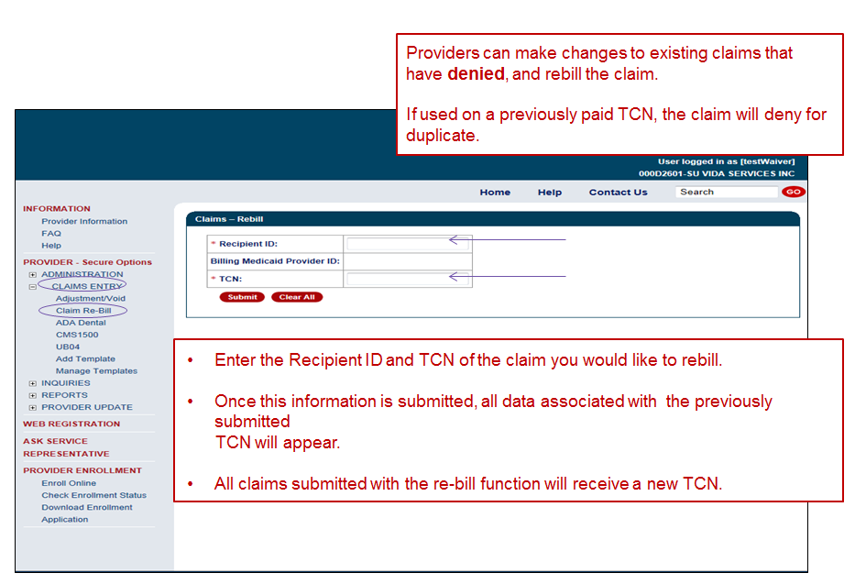

Slide 32
Claims Re-bill
Conduent
Government Healthcare Solutions

Slide 33
What Questions Do You Have?

Slide 34
What take away message do you have to share with us?

Slide 35
Resources
When online use: Ask Service Representative
HIPAA.Desk.NM@Conduent.com
NMProviderSupport@Conduent.com
Call Center 505-246-0710 or 800-299-7304
New Mexico Web Portal
Provider Information section
Links and FAQ section
Provider Login section

